Slide 1


Logistic Regression
Titanic Survival Prediction

Slide 2
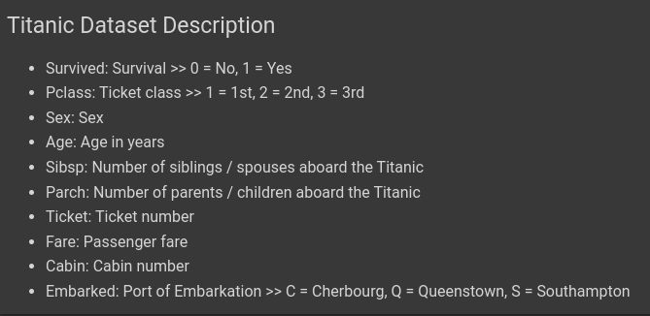
Titanic Dataset Description

Slide 3
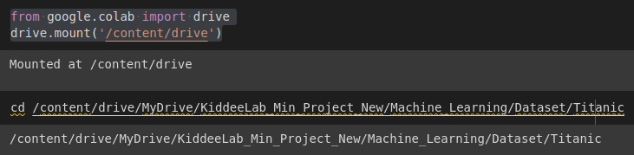
Drive Mount on Google Colab

Slide 4
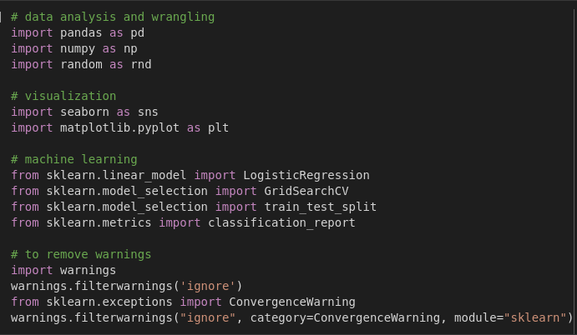
Importing Libraries

Slide 5

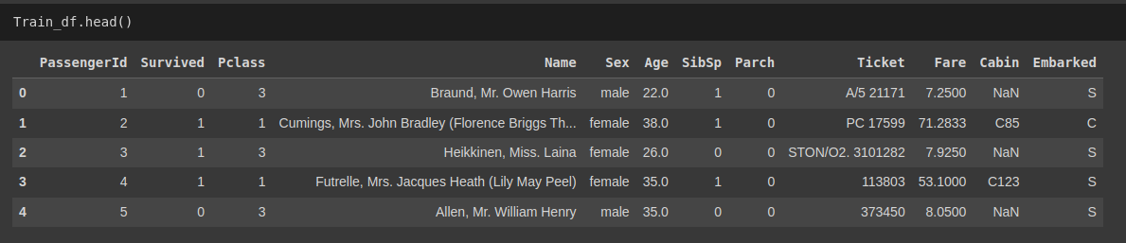
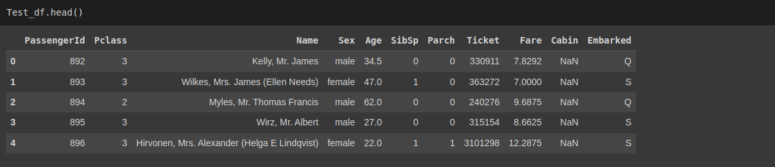
Dataset Loading and Exploration

Slide 6
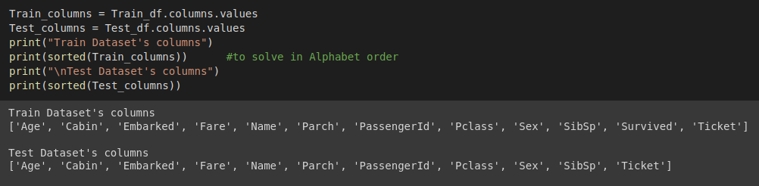
Data Exploration

Slide 7
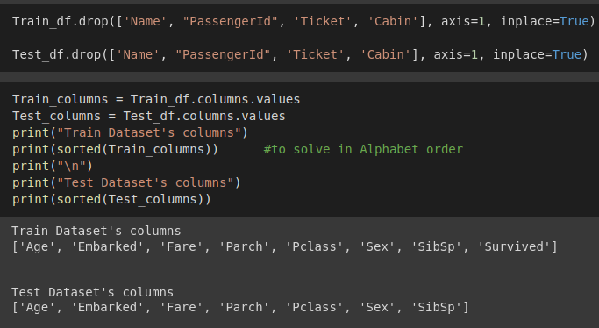
Data Preprocessing
Removing Features with domain knowledge

Slide 8
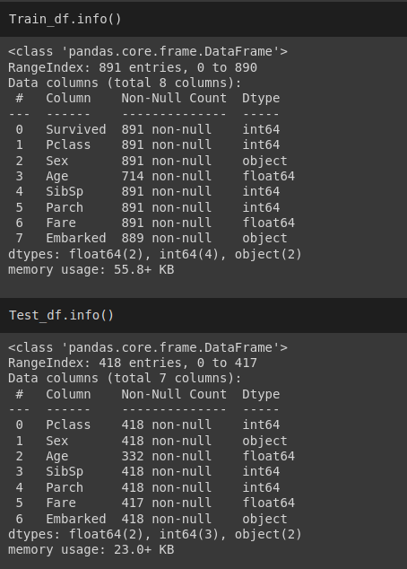
Data Exploration

Slide 9
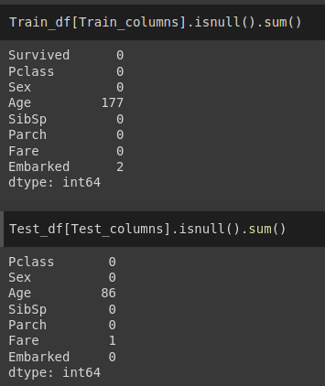
Data Exploration

Slide 10
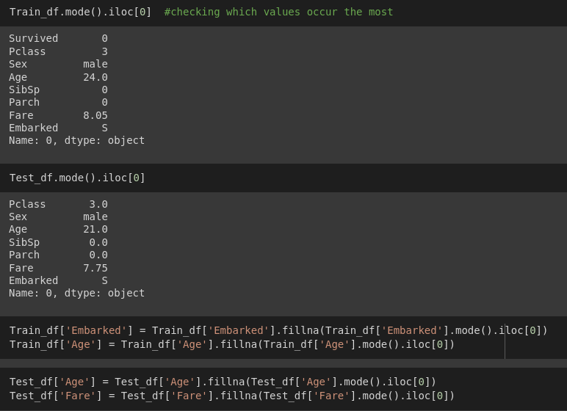
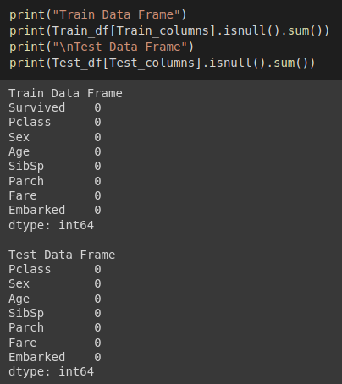
Data Exploration and Preprocessing
Filling Missing Values

Slide 11
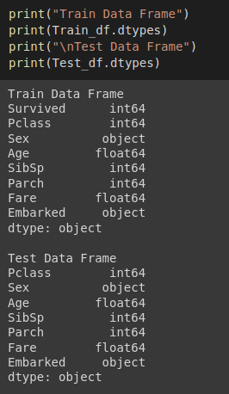
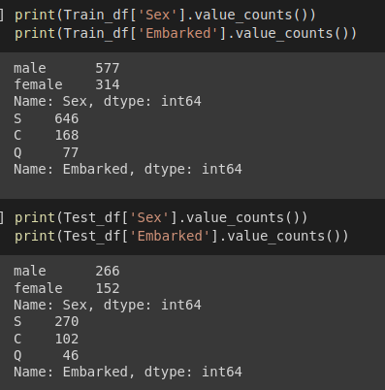
Data Exploration and Preprocessing
Data Exploration to transform the data

Slide 12
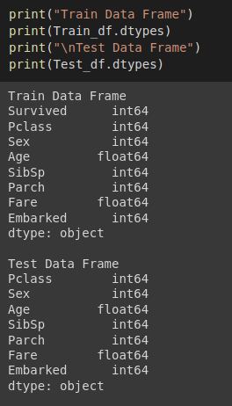
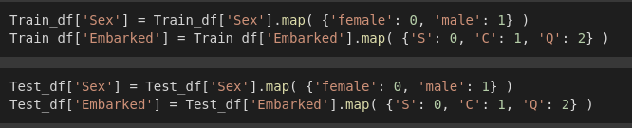
Data Exploration and Preprocessing
Data Transformation

Slide 13
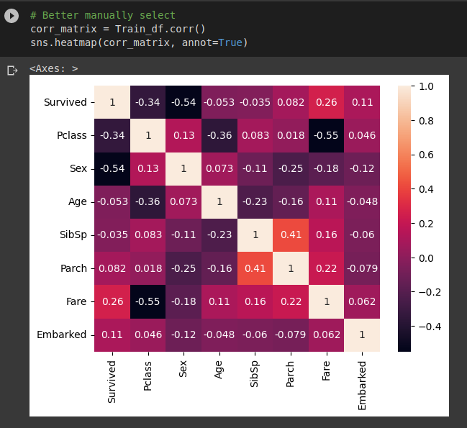
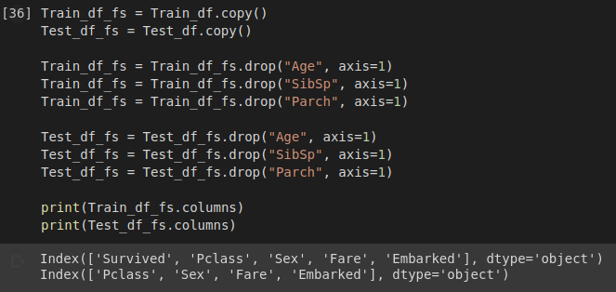
Data Exploration and Preprocessing
Feature Removal using correlation matrix

Slide 14
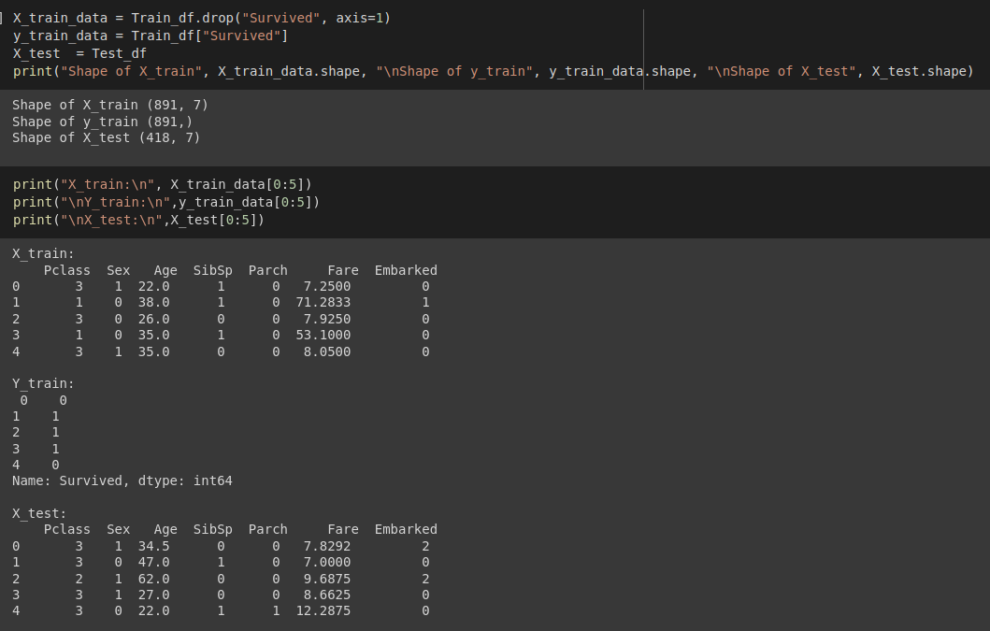
Data Preparing for Model Training
We will start our training with dataset without feature selection in data preprocessing.

Slide 15
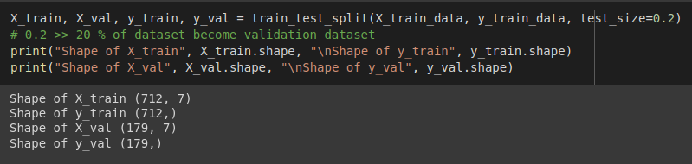
Data Preparing for Model Training
Split training dataset to training and validation data for model.
Validation data:
To check the performance of the model on new data that was not used for training.
This helps to evaluate whether the model is generalizing well to new data or overfitting to the training data.
By monitoring the performance on the validation data during training, we can adjust the hyperparameters of the model to improve its generalization performance.

Slide 16
Logistic Regression Model Solvers
Solvers for Logistic Regression
newton-cg — A newton method. Newton methods use an exact Hessian matrix. It's slow for large datasets, because it computes the second derivatives.
lbfgs — Stands for Limited-memory Broyden–Fletcher–Goldfarb–Shanno. It approximates the second derivative matrix updates with gradient evaluations. It stores only the last few updates, so it saves memory. It isn't super fast with large data sets. It will be the default solver as of Scikit-learn version 0.22.0.
liblinear — Library for Large Linear Classification. Uses a coordinate descent algorithm. Coordinate descent is based on minimizing a multivariate function by solving univariate optimization problems in a loop. In other words, it moves toward the minimum in one direction at a time. It is the default solver for Scikit-learn versions earlier than 0.22.0. It performs pretty well with high dimensionality. It does have a number of drawbacks. It can get stuck, is unable to run in parallel, and can only solve multi-class logistic regression with one-vs.-rest.
sag — Stochastic Average Gradient descent. A variation of gradient descent and incremental aggregated gradient approaches that uses a random sample of previous gradient values. Fast for big datasets.
saga — Extension of sag that also allows for L1 regularization. Should generally train faster than sag.
* Normally the best are newton-cg and liblinear for large dataset and lbfgs for small dataset. *

Slide 17
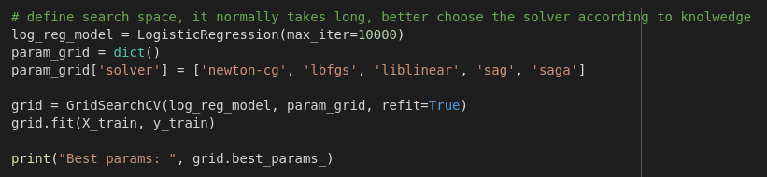
Logistic Regression Model Selection - Grid Search
Grid search is a hyperparameter optimization technique in machine learning that involves searching for the optimal hyperparameters of a model by evaluating its performance on a grid of possible hyperparameter values.
This is typically done by creating a set of possible hyperparameters to test, and then training and evaluating the model on each combination of hyperparameters in the grid.
The performance of the model on each combination is then compared, and the hyperparameters that yield the best performance are selected as the optimal hyperparameters for the model.
Grid search can be a computationally expensive process, but it is often used to optimize the performance of complex models that have many hyperparameters.

Slide 18
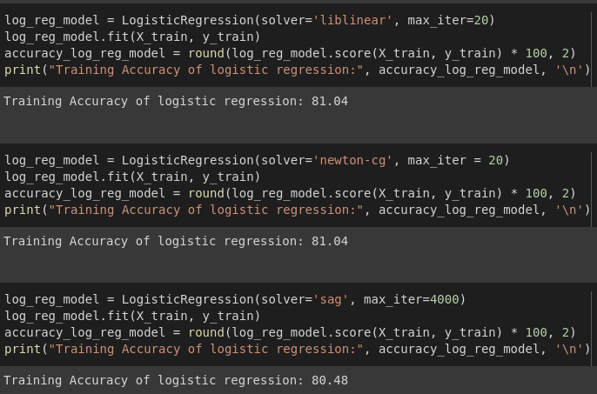
Logistic Regression Model Training

Slide 19
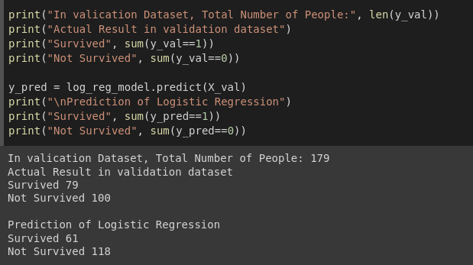
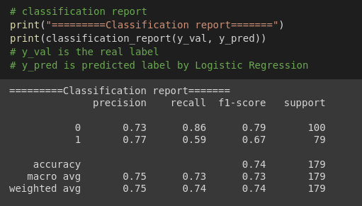
Logistic Regression Model Evaluation

Slide 20
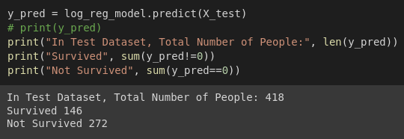
Logistic Regression Model Testing or Inference

Slide 21
Exercise
Use the dataset that we perform feature selection
Prepare data for training, validation, and testing.
Use the model that we get the highest score from previous grid search.
Train the model.
Evaluate the model.
Show result with classification report.
Test the model.

Slide 22
Application: Predict the survivability of a random person on Titanic
To perform the prediction, first we need the user input.
All input data must have same column names as you trained the model.
Then we need to preprocess the input data for model prediction.
After that, combine them as a single row dataframe.
Use this dataframe

Slide 23
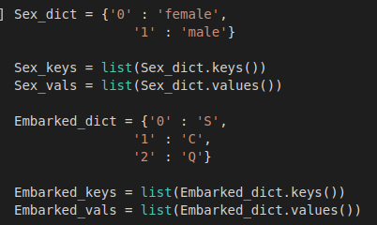
Application: Predict the survivability of a random person on Titanic
Prepare data for preprocessing.

Slide 24
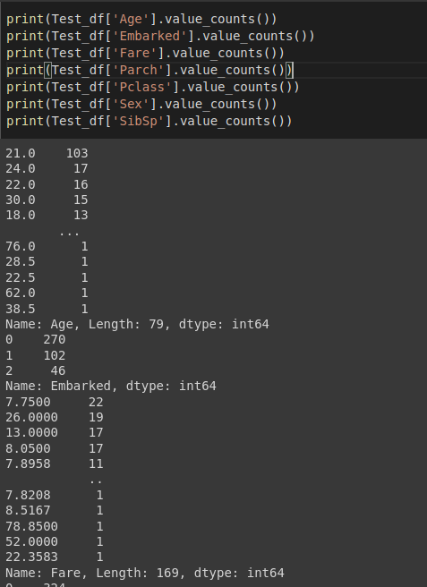
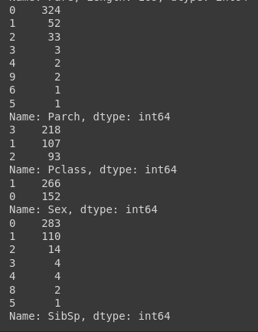
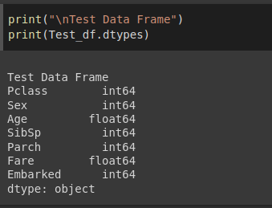

Application: Predict the survivability of a random person on Titanic
Explore data inside in test dataset again.

Slide 25
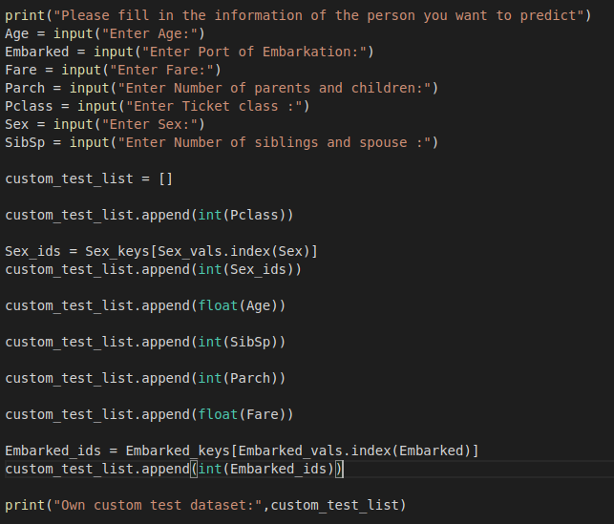
Application: Predict the survivability of a random person on Titanic
Create our own test dataset with user input

Slide 26
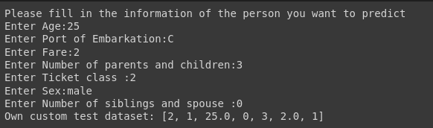
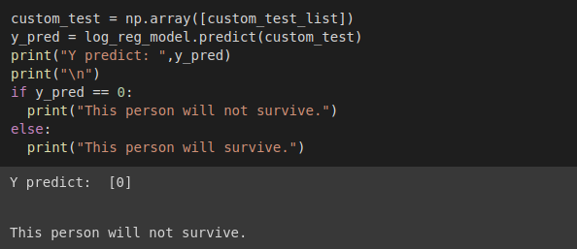
Application: Predict the survivability of a random person on Titanic
Enter the information of a random person in user inputs.
Use our created test dataset on our trained model to predict the survivability of this person.

